Slide 1
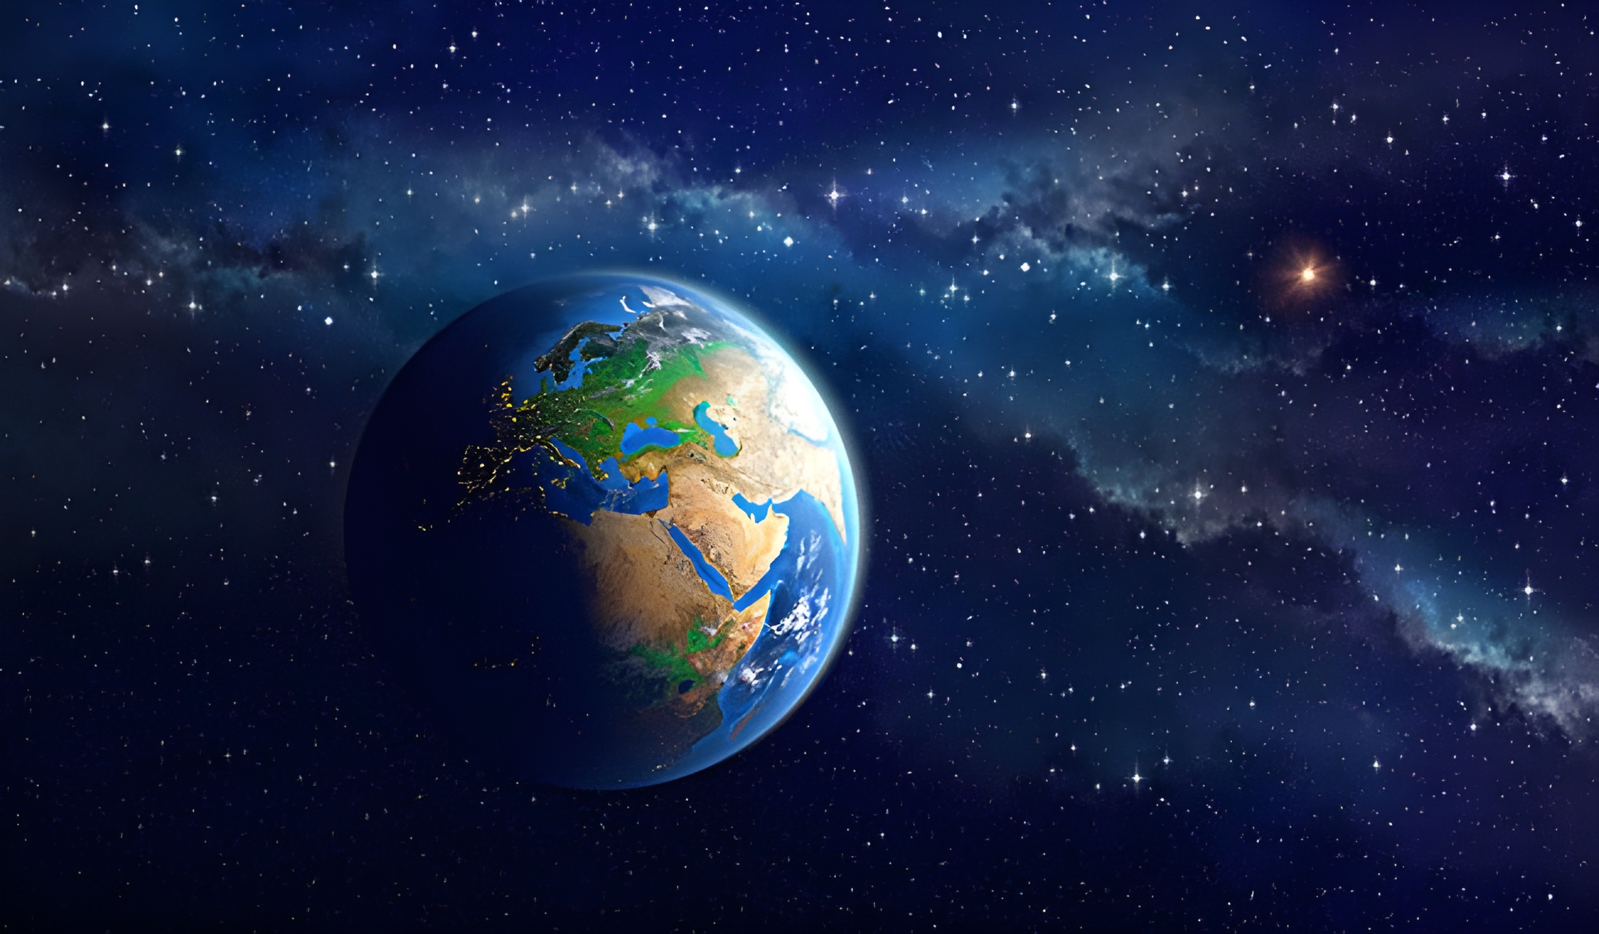
EARTH
Interior, Rocks and Minerals

Slide 2

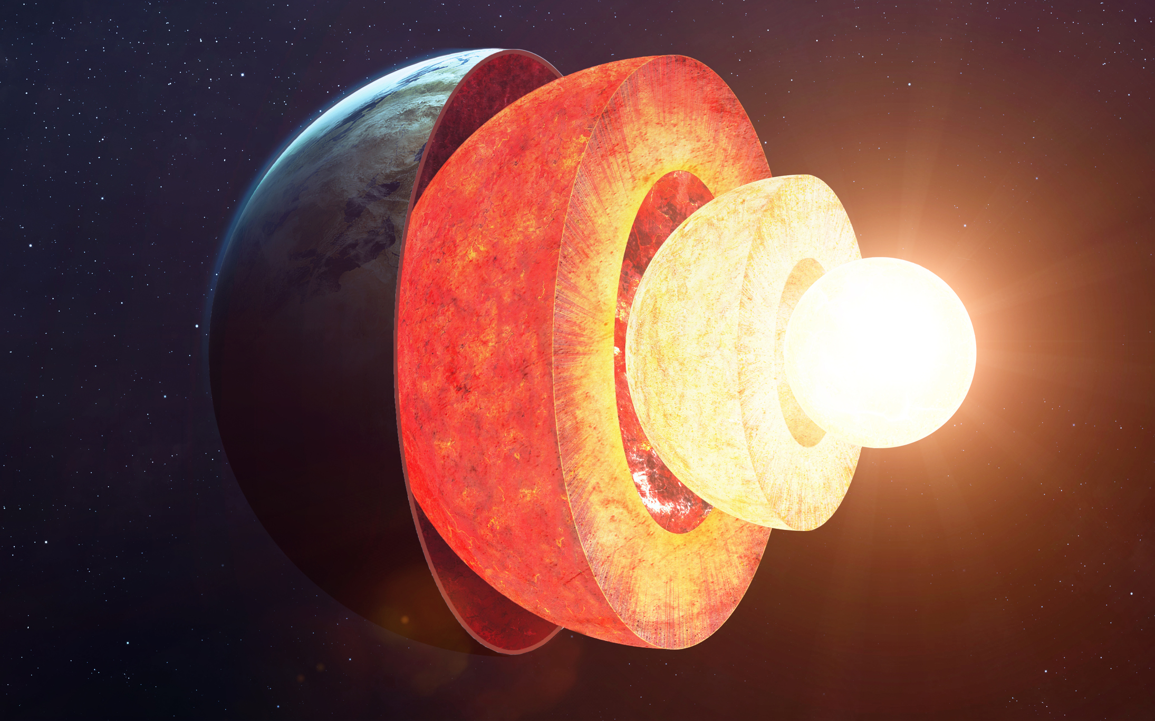
1. The Inner Core:
The inner core of the Earth is a solid, mostly iron sphere located at the planet's center and has a radius of approximately 1,220 kilometers (758 miles). The inner core is incredibly hot, with temperatures reaching 5,200° Celsius (9,392° Fahrenheit),.
4
3
2
1

Slide 3
1. The Inner Core:
The inner core of the Earth is a solid, mostly iron sphere located at the planet's center and has a radius of approximately 1,220 kilometers (758 miles). The inner core is incredibly hot, with temperatures reaching 5,200° Celsius (9,392° Fahrenheit).
4
3
2
1

Slide 4

2. The Outer Core:
The outer core is a layer inside the Earth that lies below the mantle and above the inner core. It is made of hot, melted iron and nickel. Unlike the inner core, the outer core is liquid. Because it is so hot, the metals flow around, and this movement creates Earth's magnetic field. The outer core is very thick and plays an important role in protecting our planet from harmful rays from space.
4
3
2
1

Slide 5


3. The mantle
2. The Outer Core:
The mantle is the biggest and thickest layer of the Earth. It lies between the crust and the core. It is mostly made of solid rocks that have iron and magnesium in them. The mantle takes up about 84% of the Earth’s volume. It also makes up around 67% of the Earth’s mass. Even though the mantle is solid, it can slowly move like thick liquid over a long time. This slow movement, called mantle convection, helps move the plates on Earth’s surface.
The outer core is a layer inside the Earth that lies below the mantle and above the inner core. It is made of hot, melted iron and nickel. Unlike the inner core, the outer core is liquid. Because it is so hot, the metals flow around, and this movement creates Earth's magnetic field. The outer core is very thick and plays an important role in protecting our planet from harmful rays from space.
4
3
2
1

Slide 6
4. The CRUST
The crust is the outermost layer of the Earth. It is the thinnest layer and is made of solid rock. The crust is where we live, and it includes both continental and ocean floors. It makes up only about 1% of Earth’s volume, but it's very important. The crust is broken into pieces called tectonic plates, which move slowly and can cause earthquakes, mountains, and volcanoes.
4
3
2
1

Slide 7
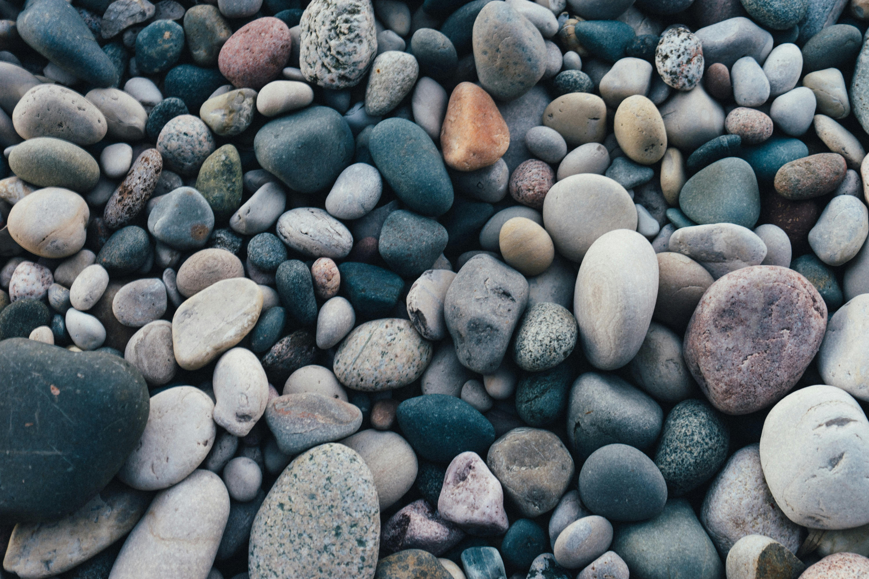
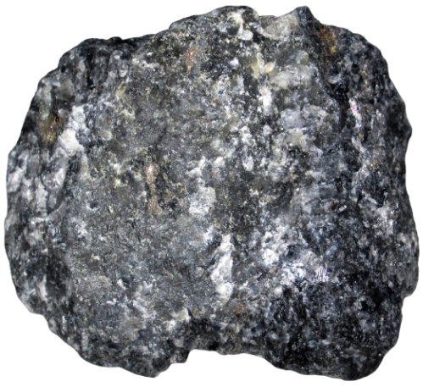
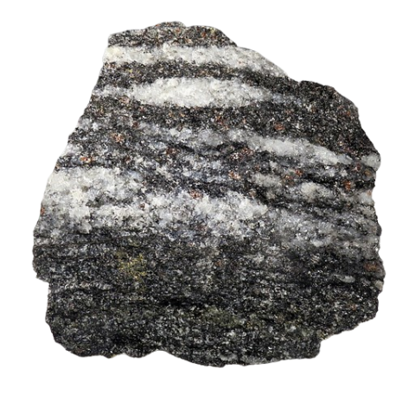
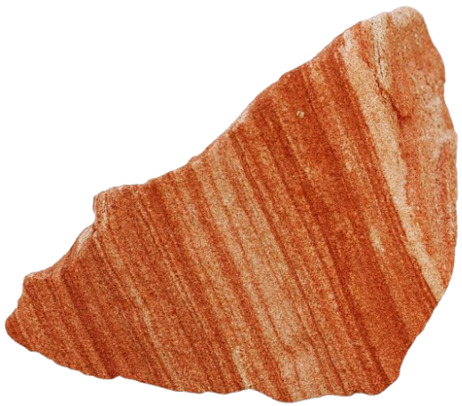
IGNEOUS
ROCK
Igneous rocks are formed when hot, melted rock (called magma or lava) cools down and becomes solid. They are one of the three main types of rocks found on Earth.
How they form: From cooled magma or lava.
Look: They are usually hard and have tiny crystals.
Uses: They are used in building roads, houses, and statues.

Slide 8
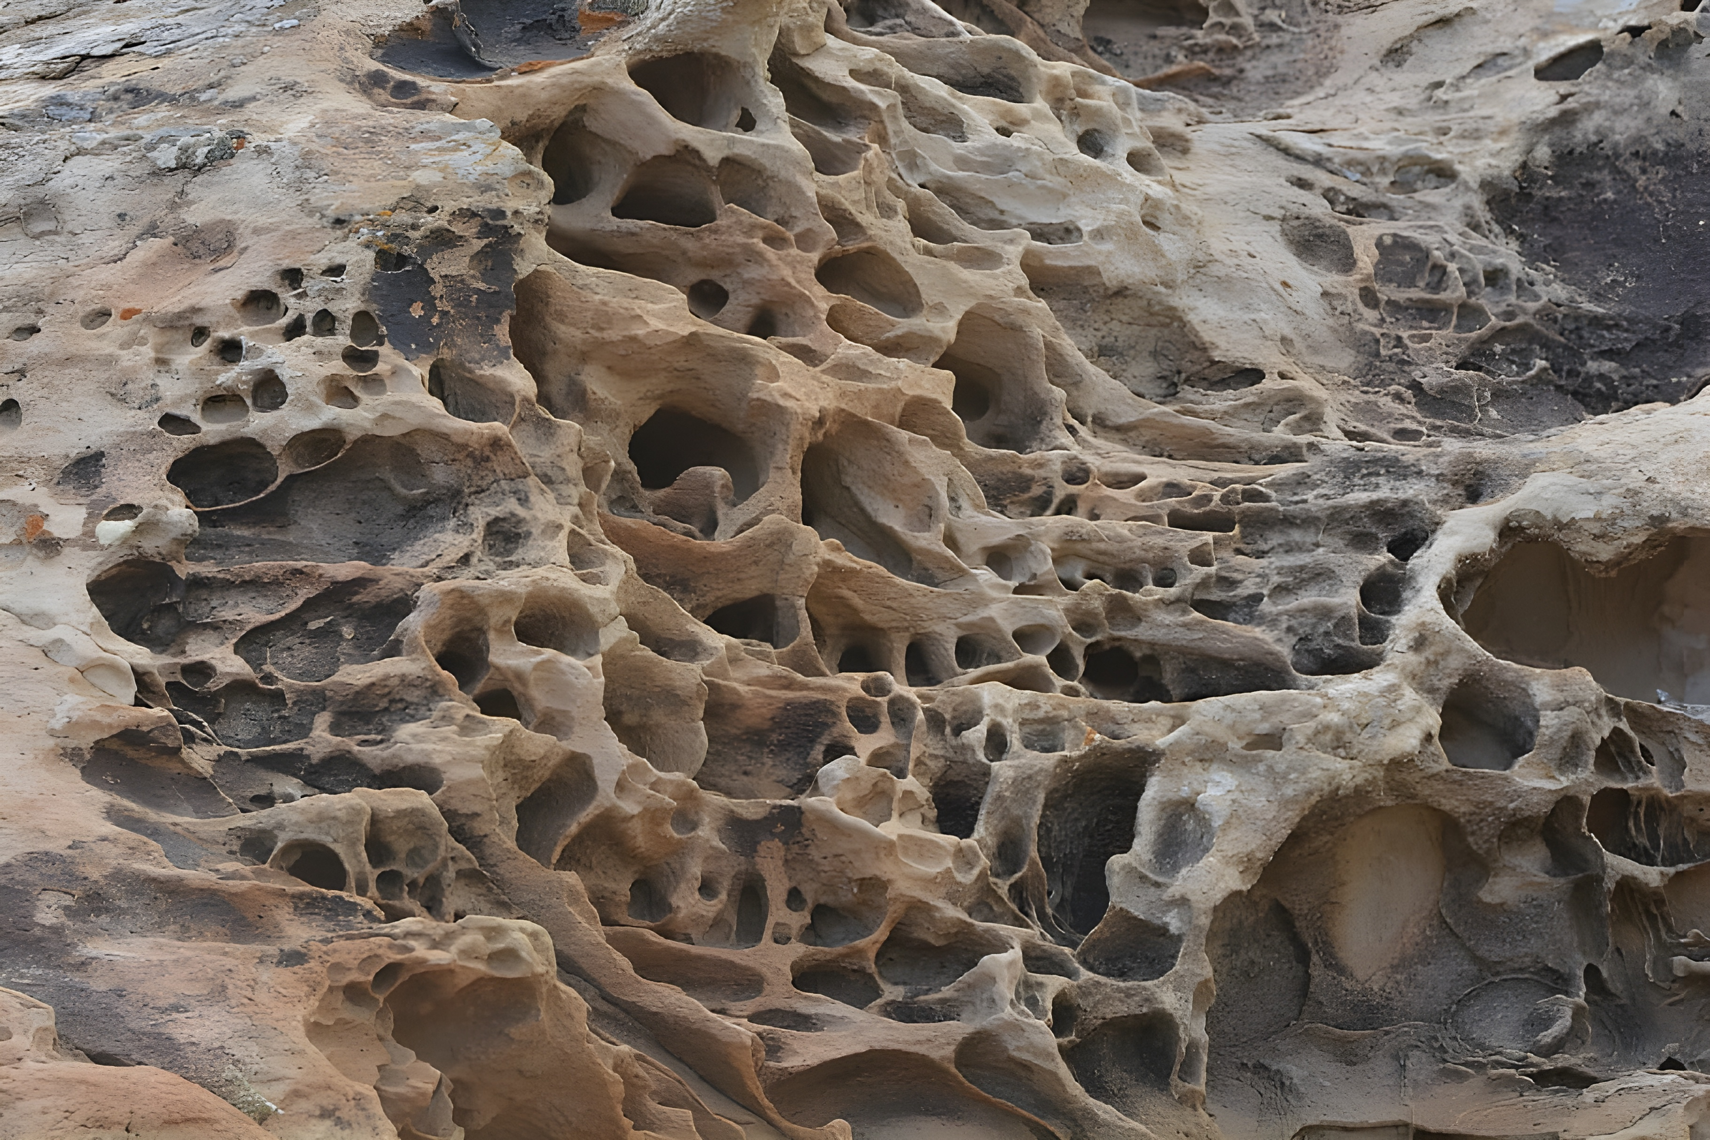
IGNEOUS
ROCK
SEDIMENTARY
ROCK
How they form: From cooled magma or lava.
Look: They are usually hard and have tiny crystals.
Uses: They are used in building roads, houses, and statues.
Igneous rocks are formed when hot, melted rock (called magma or lava) cools down and becomes solid. They are one of the three main types of rocks found on Earth.

Slide 9
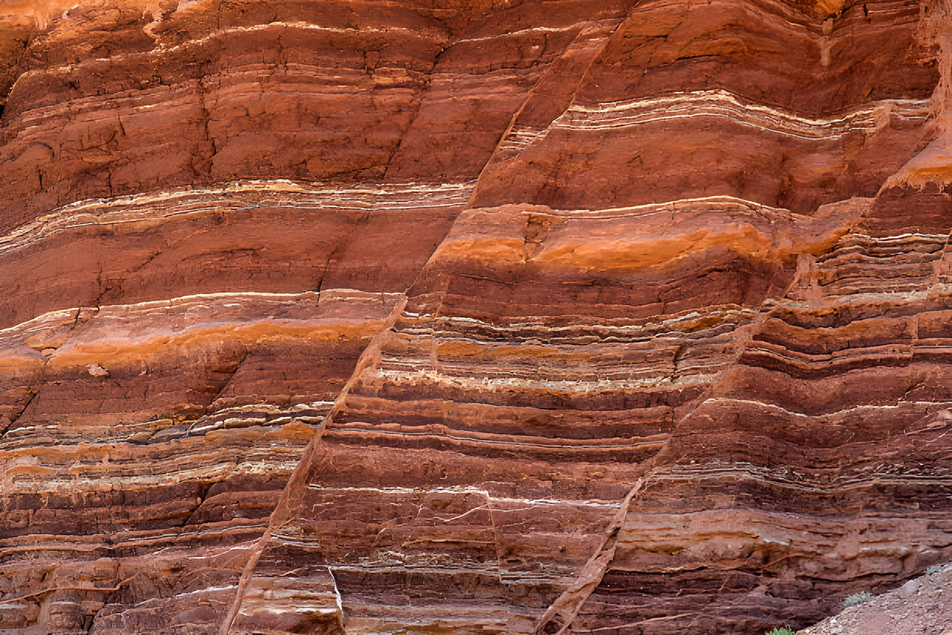
IGNEOUS
ROCK
METAMORPHIC
ROCK
SEDIMENTARY
ROCK
IGNEOUS
ROCK
How they form: From layers of rock pieces and sand pressed together.
Look: They often have layers and may contain fossils.
Uses: Used in making cement, bricks, and roads.
Sedimentary rocks are formed from small pieces of rocks and sand that get pressed together over time. These pieces settle in layers, usually at the bottom of rivers, lakes, or oceans.

Slide 10
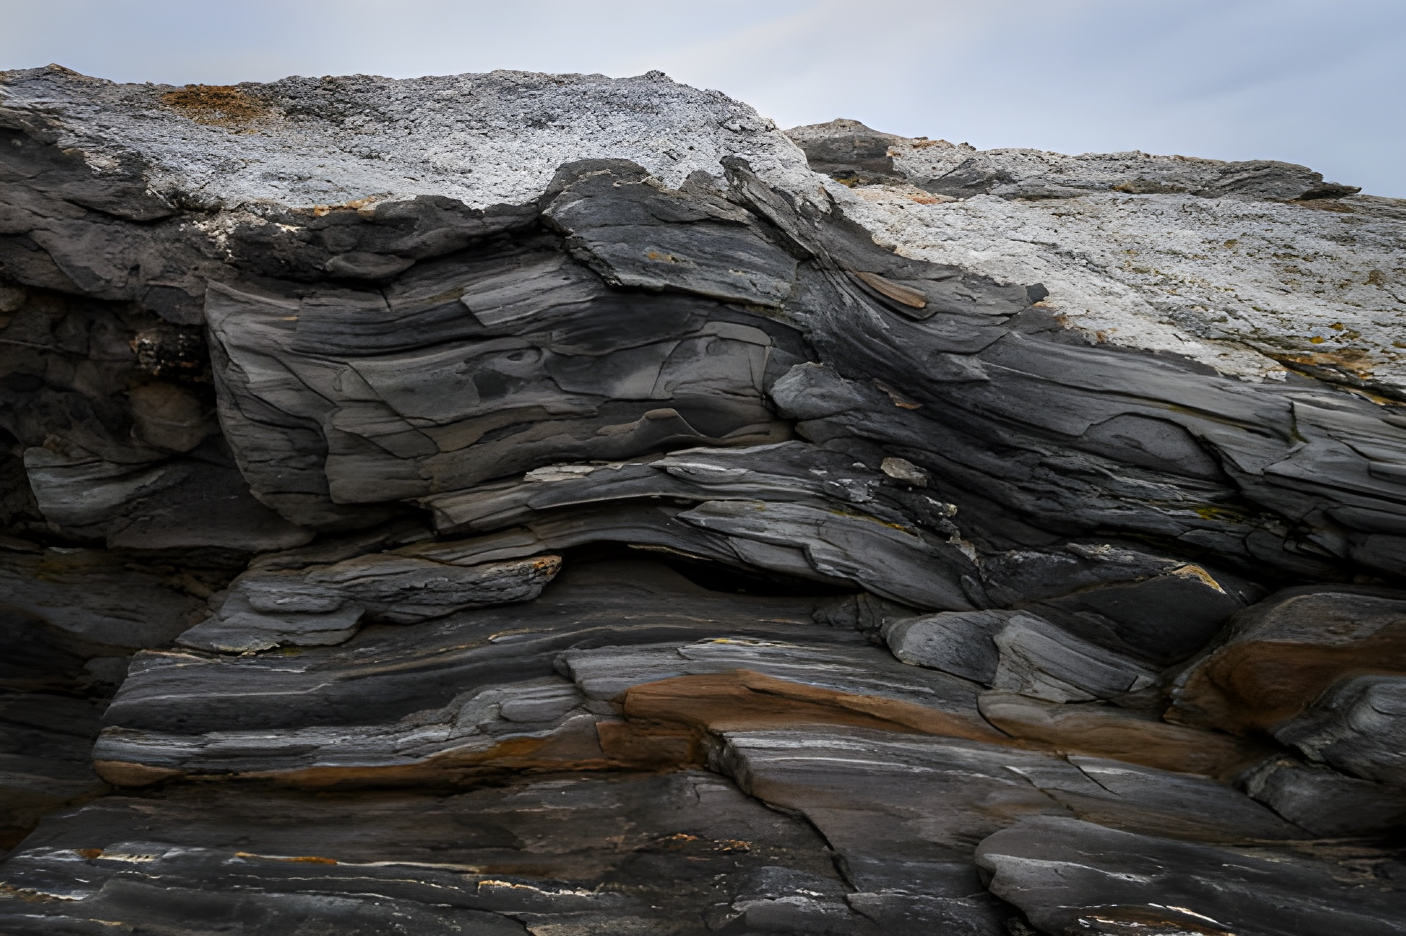
THANK YOU
IGNEOUS
ROCK
METAMORPHIC
ROCK
IGNEOUS
ROCK
SEDIMENTARY
ROCK
How they form: From other rocks changed by heat and pressure.
Look: They are usually hard and may have layers or a shiny surface.
Uses: Used in buildings, floors, and statues.
Metamorphic rocks are formed when other rocks change due to heat and pressure inside the Earth. This process makes the rocks harder and sometimes gives them a shiny look.

Slide 11
IGNEOUS
ROCK
METAMORPHIC
ROCK
SEDIMENTARY
ROCK
IGNEOUS
ROCK
THANK YOU
How they form: From other rocks changed by heat and pressure.
Look: They are usually hard and may have layers or a shiny surface.
Uses: Used in buildings, floors, and statues.
Metamorphic rocks are formed when other rocks change due to heat and pressure inside the Earth. This process makes the rocks harder and sometimes gives them a shiny look.

